Slide 1
Generating Research Topics and Writing Analytically

Slide 2
What does it mean to Analyze?
Analyze means to separate a subject into its parts (analyze), or the act or result of doing so.
The process of analyzing involves breaking an object into its parts and examining those parts.

Slide 3
What is Analytical Writing?
Analytical writing:
  Evaluates data
  Distinguishes the important from the less important
  Relates one idea and its details to another

Slide 4
Analytical Writing
An analytical paper:
  Breaks down an issue or an idea into its component parts
  Evaluates the issue or idea
  Presents this breakdown/evaluation while providing interpretation/drawing conclusions

Slide 5
Analyzing when Writing
When analyzing a piece of writing, first examine your response to the elements of the work.
Brainstorm your ideas about the work you are analyzing.
Create a working thesis (statement of purpose) about the piece you are analyzing.

Slide 6
Analytical Writers Should…
Organize material in a proper manner
Reveal that organization in the document
Help the reader recognize the logical development of the writing and see how the bits and pieces fit together

Slide 7
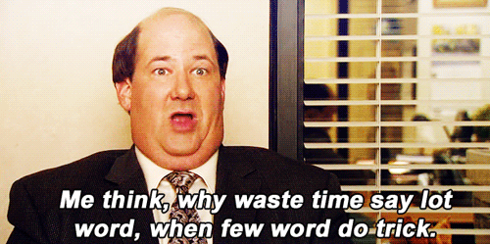
Basic Principles of Writing
Clarity
Conciseness
Correctness
  Precision
  Mechanical correctness

Slide 8
Important Writing Tips
Emphasize use of simple and complex sentences
Great variety of word order of the sentences
Tie ideas together and discriminate among details
Emphasize use of one and two syllable words

Slide 9
Important Writing Tips
Minimize use of internal punctuation
Thoughtful use of dependent clauses and no prepositional phrases
Sentences should not normally begin with a dependent word, phrase or clause

Slide 10

Picking your Topic
Background reading is an important first step
  Intro textbooks, Wikipedia, search-engines
  Goal of this stage is to identify some broad topics you like

Slide 11
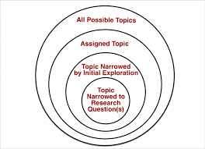
Narrow Down your Ideas
Pick a topic you like from your background reading
  Cognitive Psychology → Memory
  What interests you about memory?
    False-memories, memory loss from Alzheimer’s etc.

Slide 12
Start Researching!
More reading! Time to start finding journal articles, specialized books, etc.
The library, Google Scholar, and EBSCOhost are all good resources
What’s already been done on this topic? What gaps are there in the literature?
Pick something you enjoy or find interesting!

Slide 13
Formulating a Research Question
What does it mean to have an “idea”?
  Answers a question; explains something that needs explaining
  Connect elements of a subject and provide explanation
  Attempts to answer a “puzzling” observation

Slide 14
Formulating a Research Question
Thesis Statement: Summarizes the main points or claims of an argument
A good research paper has a strong thesis
  Specific and precise
  Makes a claim
  Supported by evidence

Slide 15
Weak Thesis Statement Example
Not advancing the idea to be explored:
Example:
  “This paper addresses the characteristics of a good corporate manager”
  What claim is it making?
Better:
  A manager’s drive to succeed makes for effective management; however, it can also make the leader domineering and ineffective.

Slide 16
Weak Thesis Statement Example
Overly broad claim
Example:
  “Violent revolutions have had both positive and negative results”
Better:
  “Although violent revolutions address long-standing social problems, they often produce mass suffering.”

Slide 17
Writing Stages
Pre-writing: the writer clarifies the task, acquires new knowledge, re-appraises existing knowledge and understanding.
Drafting: the writer roughs out key ideas and their relationship, clarifies the relationship between claims, evidence and argument.
Revision: the writer critiques the work-in-progress and revise and complete its emerging design.
Edit: the writer reads the work for clarity, focus and reasoning, standard use of language and grammar.

Slide 18
Important Information
Term paper!
  Topic Submission due 9/6 @ 11:59pm!
  1 on 1 Topic meetings (No Class 9/1)
  Writing prompts now posted on D2L!
    Not required but useful starting point.

